Slide 1
Three Components of an SLO
Professional Learning for LEA STATs and School STATs
Kerrie Naylor, PhD
USOE Specialist
Notes:
This professional learning PPT is intended to be used with district and school leaders to give them the skills and knowledge to assist classroom teachers in developing student learning objectives that can be used to measure student growth and apply the results to educator evaluation. Please feel free to modify, edit, reframe, etc. to make this document appropriate for your context. If you have any questions, call Kerrie Naylor (801-538-7950) or email kerrie.naylor@schools.utah.gov

Slide 2
Expected Outcomes
Deepen the understanding of a SLO
  Learning Goal
  Assessments
  Targets
Engage in activities
  Identify weak and strong learning goals
  Understand the elements of high quality assessments
  Determine baseline data for setting targets
  Successfully use the Utah Rubric for Assessing Quality SLOs
Apply your learning to your District/School STATs and professional learning for teachers needing to develop SLOs
Notes:
In addition to the expectation that you will develop additional SLOs, we have the following expected outcomes for today.
Deepen understanding of Depth-of-Knowledge
Deepen understanding of a SLO
Learning Goal
Assessments
Targets
Successfully use the SLO Template
Successfully use the Rubric for Assessing Quality SLOs
Understand the elements of a high quality assessment
Most importantly, we want you to develop knowledge, expertise, and skill in leading your writing groups in tomorrow’s work.
The experiences that you have with the SLO tools will help gain a deeper understanding of complexity of SLOs and how they can be used to provide evidence of student learning that can be applied to an educator’s rating for evaluation.
Next slide

Slide 3
What are SLOs and what are the three components?
SLOs
Learning Goals
Targets
Assessments
Notes:
I visualize an SLO as an umbrella that covers three key parts. These parts or components are necessary to make an SLO work and measure evidence of student growth and learning with validity and reliability. The three components have to be cohesive and aligned or the analytic method to measure growth won’t meet the criteria for fairness and accuracy.
Next slide

Slide 4
An SLO comprises three aspects
Learning Goal
A description of what students will be able to do at the end of the course or grade
It is based on the intended standards and curriculum that are being taught and learned,
As close to the individual student as possible, allowing for a variation based on the current achievement levels of individual groups of students.
Assessment
Target
Identify the expected outcome by the end of the instructional period.
May differ for subgroups of students.
There are two key components of the targets associated with SLO:
Starting level: if we expect all students to all achieve the same end goal, then we can skip this step, but more likely there will be some differentiation of goals.
End goal: what performance demonstrates that students met the learning goal using your assessments?
Standards-based
Designed to best measure the knowledge and skills found in the Learning Goal
Accompanied by clear criteria or rubrics to determine student learning from the assessment
High quality measures used to evaluate the degree to which students achieved the developed Learning Goal.
Assessments should be used to support and measure the Learning Goal, not vice versa.
Notes:
Learning Goal:
A description of what students will be able to do at the end of the course or grade
It is based on the intended standards and curriculum that are being taught and learned,
As close to the individual student as possible, allowing for a variation based on the current achievement levels of individual groups of students
Assessments:
Standards-based
Designed to best measure the knowledge and skills found in the Learning Goal
Accompanied by clear criteria or rubrics to determine student learning from the assessment
High quality measures used to evaluate the degree to which students achieved the developed Learning Goal.
Assessments should be used to support and measure the Learning Goal, not vice versa.
Targets:
Identify the expected outcome by the end of the instructional period.
May differ for subgroups of students.
There are two key components of the targets associated with SLO:
Starting level: if we expect all students to all achieve the same end goal, then we can skip this step, but more likely there will be some differentiation of goals.
End goal: what performance demonstrates that students met the learning goal using your assessments?
Next slide

Slide 5
Non-Tested Subjects and Grades
Non-tested subjects & grades (NTSG): These are all the courses, subject areas, and grade levels without at least two consecutive years of state-level standardized tests.
In Utah, this includes everything other than grades 3-11 in ELA, grades 4-10 science, and grades 3-11 mathematics.
All Elementary Language Arts (ELA)(Grades 3, 4, 5, 6)
All Secondary Language Arts (ELA) (Grades 7, 8, 9, 10, 11)
All Elementary Math (Grades 3, 4, 5, 6)
All Secondary Math (Grades 7, 8, Pre-Algebra, Algebra I, Geometry, Algebra II)
All Elementary Science (Grades 4, 5, 6)
All Secondary Science (Grades 7, 8, ESS, Biology, Chemistry, Physics)
Notes:
When we refer to “non-tested subjects and grades”, we are talking about all the courses, subject areas, and grade levels without at least two consecutive years of state-level standardized tests. In most states, this includes everything other than grades 4-8 in reading and mathematics. In Utah, you can see that science is also included.

Slide 6
What are SLOs?
SLOs are content- and grade/course specific learning goals describing what students should know and be able to do at the end of that course or grade.
SLOs are ambitious and realistic learning targets established for groups of students.
SLOs can be measured (assessed) to document student growth and learning over a period of time.
Notes:
So, what are SLOs?
SLOs are a general approach which is content- and grade or course specific learning objectives describing what students should know and be able to do at the end of that course or grade.
They are ambitious and realistic learning goals established for individual or groups of students.
SLOs can be measured to document student learning over a period of time. This means that they can be used as a way to apply the contribution of a educator or group of educators to students’ learning.

Slide 7
Why are SLOs Important?
SLOs:
In addition to measuring student growth and learning to apply to the contributions to educator evaluation,
SLOs:
Put student learning first.
  Student proficiency of content and skills is the primary focus.
Prioritize key standards/enduring understandings.
  Teachers ask themselves, “What do my students need to know to be successful?”
Improve the quality of student data use.
  The SLO process will provide explicit guidance for teachers in selecting and gather student data.
Make teacher impact on student achievement visible.
Based on data, instruction can be adjusted and differentiated in real time for maximum student achievement.
Notes:
Why are student learning objectives (SLOs) important?
SLOs put student learning first. Student proficiency of content and skills is the primary focus.
They prioritize key standards and enduring understandings. When thinking about Learning Goals, teachers can ask themselves, “What do my students need to know to be successful?”
SLOs improve the quality of student data use. The SLO process will provide explicit guidance for teachers in selecting and gather student data.
And finally, SLOs will make the teacher’s impact on student achievement visible.
Based on data, instruction can be adjusted and differentiated in real time for maximum student achievement.
Many states have already begun using student movement toward standards proficiency through the SLO process as a means of accountability. SLOs are content- and grade or course-specific learning objectives that can be validly measured to document student learning over a defined and significant period of time (e.g., semester or year). At their root, SLOs can constitute an instructional improvement process, driven by teachers in all grades and subjects.

Slide 8
SLO Opportunities
Are inclusive of all educators and standards
All subjects, all grades, regardless of current state/district-mandated assessments
Encourage effective instructional practices
Setting meaningful goals
Providing opportunities for collaboration and feedback across educators sharing goals
Monitoring progress toward those goals
Evaluating the extent to which those goals are achieved using student evidence
Improve instructional practice
Notes:
Why use SLOs? Educational systems across the country are developing teacher evaluation systems that require student achievement as a factor for determining the overall effectiveness of educators. SLOs have been proposed as an option that provides several opportunities:
SLOs can be used with all tested and non-tested subjects and grades to help monitor and improve student learning as well as determine student growth.
SLOs encourage effective instructional practices. These practices include having teachers:
set meaningful goals for student achievement of standards in a rigorous manner;
provide opportunities for educators to establish goals collaboratively and/or to receive feedback on goals and measures for evaluating student success;
provide incentive for teachers to monitor student progress toward these meaningful goals;
evaluate the extent to which the learning objectives are achieved based on student evidence from the identified selected or designed assessments; and
allow for improved instructional practice.

Slide 9
SLO Challenges
Will require significant Professional Development and oversight to establish meaningful and comparable goals
Potential for corruption on goals, measures, and targets
Still requires high quality assessments to measure goals and evaluate targets
Setting rigorous but realistic targets for all students
Notes:
Of course, as with any strategy to be employed, there are always challenges, and SLOs are no exception!
In order to establish meaningful and comparable goals across a district, a significant amount of professional development will be required.
This professional development stretches from
guiding teachers and educators in writing learning goals,
selecting or creating high-quality assessments that are aligned to standards, enduring understandings, and high levels of cognitive rigor expected from the learning goal,
developing attainable and rigorous targets to
oversight by evaluators ensuring that all these elements are comparable from teacher-to-teacher, grade-to-grade, and school-to-school.
As we start to use SLOs for accountability purposes, it is important that we guard against the corruption of goals, measures and targets. SLOs will require high quality assessments to measure the learning goals and evaluate the established targets.
And SLOs require setting targets for all students. This will require identifying appropriate data sources for determining starting points of students, analyzing these data and trends, as well as determining how to use this information to set rigorous but realistic targets for all students.

Slide 10
SLO Three Components
Student Learning Objectives
Learning Goal
Assessments
Targets
Notes:
Let’s recap…
An SLO is an acronym for Student Learning Objectives
An SLO has 3 components: a learning goal, assessments, and targets
Writing, implementing, and evaluating an SLO is a process that allows for teaching and learning opportunities

Slide 11
Learning Goal
Notes:
Now we will begin work on the first key component of the SLO process: the SLO Learning Goal.
We will learn what a learning goal is, how it is aligned to the big ideas, and how to ensure that it expects students to demonstrate high levels of cognitive rigor. Finally, you will examine examples of Learning Goals and he planning documentation, and then evaluate their quality based on the SLO Quality Assessment Rubric and SLO Review Tool.

Slide 12
Learning Goal
A Learning Goal: describes what students will be able to do at the end of the course or grade level based on course - or grade-level Utah Core content standards and curriculum.
The learning goal:
includes a specific and measurable description of the big ideas that students will be able to know and demonstrate at the end of the course/grade.
contains critical content and skills from the intended standards and curriculum that are being taught and learned (not all content and skills).
is a demonstration of deep understanding.
Notes:
An SLO requires coordination of three key components: learning goal, assessments, and targets.
Let’s talk about learning goal first. A learning goal is a description of an ambitious and realistic big idea that describes what a student needs to know and be able to do at the end of a course or grade.
It includes:
a specific and measurable description of what students will be able to do at the end of the course/grade,
critical content and skills from the intended standards and curriculum that are being taught and learned, and
a demonstration of deep understanding.

Slide 13
The SMART Approach
Specific: The learning goal is focused, for example, by content standards and by learners’ needs.
Measurable: An appropriate instrument/measure is selected to assess the learning goal.
Appropriate: The learning goal is within the teacher’s control to effect change and is a worthwhile focus for the students’ academic year.
Realistic: The learning goal is feasible for the teacher.
Time limited: The learning goal is contained within a single school year or appropriate unit of time.
Notes:
To help you map out the different pieces of the learning goal section, we advise using the “SMART” approach. We will go through each letter of this acronym and show how each is tied to different parts of the template.
The SMART Approach stands for the following:
S is for Specific: The learning goal is focused, for example, by content standards; by learners’ needs.
M is for Measurable: An appropriate instrument/measure is selected to assess the learning goal .
A is for Appropriate: The learning goal is within the teacher’s control to effect change and is a worthwhile focus for the students’ academic year.
R is for Realistic: The learning goal is feasible for the teacher.
T is for Time limited: The learning goal is contained within a single school year or appropriate unit of time.

Slide 14
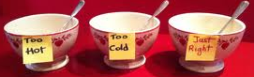
Specific
The learning goal is focused, for example, by content standards; by learners’ needs.
Goldilocks Dilemma:
  Too broad → difficult to measure well.
  Too narrow → too discrete and piecemeal.
What is “just right?”
Notes:
When we say we want the learning goal to be specific, we are also saying we want the learning goal to be focused. For example, a learning goal can be specific by content standards (we have a section for specific standards in the template) or by learners’ needs (let’s say there is a high level idea based on a pre-test that students are struggling with).
The issue with Specific is about what the right grain size is.
If the learning goal is too broad, then it’s difficult to measure well because there is too much to cover and too few items to truly measure something that big.
If the learning goal is too narrow, then it may not be measuring anything beyond a single standard. This could lead to teaching content in piecemeal or fragmented ways, which won’t help students see connections in what they learn.
So, one of the things you learn to finesse in writing a learning goal is finding out what is “just right.” We call this the Goldilocks Dilemma. As she did, you need to keep trying to refine it to the right size.
Specific is addressed by the “big idea” and “content standards” parts of the template.

Slide 15

Measurable
An appropriate instrument/measure is selected to assess the learning goal (assessment).
It is critical that we find valid assessments to measure the degree to which students achieve the learning goals.
Notes:
Measureable relates to assessments. We want to know that there is something being used that can actually measure the goal. Not only that, the instrument/measure selected to assess the learning goal must be appropriate and valid.
It is critical that we find valid tools to measure the degree to which students achieve the learning goals.
We discuss how the learning goal is measured in the assessments section of the SLO.

Slide 16
Appropriate
The Learning Goal
is within the teacher’s control to effect change and is a worthwhile focus for the students’ academic year.
must be designed in ways that the teacher feels like they have a fair chance to succeed
should be ambitious enough to require high quality teaching to achieve.
Notes:
When we talk about appropriate, we want to make sure that:
The learning goal is within the teacher’s control to effect change and is a worthwhile focus for the students’ academic year.
The learning goal must be designed in ways that the teacher feels like s/he has a fair chance to succeed
The learning goal should also be ambitious enough to require high quality teaching to achieve.
Appropriate is addressed in the “important and meaningful” and “deep understanding” sections of the template.

Slide 17
Realistic
The learning goal is feasible for the teacher to teach.
While ambitious, the learning goals must be achievable, not just for the extraordinary teacher, but also for most effective teachers.
Notes:
R stands for Realistic.
This is to ensure that the learning goal is feasible for the teacher to teach. While we want the learning goal to be ambitious, they must also be achievable, not just for the extraordinary teacher, but also for most effective teachers.
Realistic is addresses by the “instruction and strategies” and “time span” pieces of the template.

Slide 18

Time Limited
The learning goal is contained within a single school year or appropriate unit of time (semester or term).
The learning goal must be written so they can be summatively evaluated within the time under the teacher’s control.
Notes:
Lastly, we have Time Limited.
As you saw in the template, we have two time span pieces. When we include time limited here, we want to be sure the learning goal is contained within a single school year or appropriate unit of time (for instance, a semester long course would have the time frame limited to within when a teacher has students to teach). Similarly, the learning goal must be written so it can be summatively evaluated within the time under the teacher’s control. The reason for this is so when you get to the Targets section, you have data you can collect to show what progress your students have made.
Time limited is addressed in the Time Span section of the template.

Slide 19

Learning Goal Requirements
There are two major concepts that require our attention in order to write a high-quality Learning Goal:
What is a Big Idea and how do I identify one?
What is cognitive rigor and how do I know if the Learning Goal requires deep understanding?
Notes:
Let’s go back to some of the expectations found in the creation of a Learning Goal.
There are two major concepts that require our attention in order to write a high-quality Learning Goal:
1) What is a Big Idea and how do identify a Big Idea?
2)What is deep understanding and how do I know if the Learning Goal requires deep understanding?

Slide 20
Big Ideas
Why is it important to consider the
“big ideas” when developing Learning Goals?
Thread that links units, lessons, and year-to-year teaching
Focus daily classroom activity on meaningful ideas that are important for students to know and demonstrate
Way to think about standards and curriculum that helps us answer the question: Why does it matter?
Notes:
Why is it important to consider the big ideas when developing a Learning Goal?
“Big ideas” are the thread that links units, lessons, and year-to-year teaching. They provide a way to focus daily classroom activity on meaningful -ones that are important for students to know and demonstrate. Big ideas are a way to think about standards and curriculum that helps us answer the question: Why does it matter?
Important or “big ideas” are central to a discipline or course and have lasting value beyond the classroom. Big ideas synthesize what students should understand—not just discrete knowledge—as a result of studying a particular content area. Moreover, they articulate what students should “revisit” over the course of their lifetimes in relationship to the content area.

Slide 21
Example: Standard Big Idea
Content Standard:
Comprehend and interpret information from a variety of graphic displays including diagrams, charts, and graphs.
Big Idea:
Graphic displays of information enhances comprehension and interpretation of information.
Notes:
Let’s look at an example: If the standard states:
Comprehend and interpret information from a variety of graphic displays including diagrams, charts, and graphs.
The verbs are “comprehend” and “interpret” and the noun is “graphic displays”.
A big idea from this standard could be: Graphic displays of information enhance comprehension and interpretation of information.

Slide 22
Determining the Big Idea
Standards:
Contrast the essential rights and responsibilities of citizens in systems of government, such as Autocracy, Democracy, Oligarchy, and Republic.
Analyze citizens’ rights and responsibilities in local, state and national government.
Analyze skills used to resolve conflicts in society and government.
Analyze political leadership and public service in a republican form of government.
Explain the importance of the political process to competent and responsible participation in civic life.
Analyze the consequences of violating laws of Pennsylvania compared to those of the United States.
Analyze political and civic participation in government and society.
Big Idea:
Citizens understand their rights and practice their responsibilities while analyzing situations within a vibrant society.
Notes:
This is a little trickier! The nouns seem to focus on civic and rights and responsibilities. The verb “analyze” seems to be the focus here.
A big idea from this standard could be: Citizens understand their rights and practice their responsibilities while analyzing situations within a vibrant society.

Slide 23
Examples of Big Ideas
Art: Great artists often break with conventions to better express what they see and feel.
Economics: Price is a function of supply and demand.
Biology: Through a variety of mechanisms all organisms seek to maintain a biological balance between their internal and external environments.
Mathematics: Math models simplify physical relations –and even sometimes distort relations – to deepen our understanding of them.
ELA: The storyteller rarely tells the meaning of the story.
World Language: Understanding idiomatic expressions and using them wisely.
Notes:
This is a listing of other possible Big Ideas that may assist you as you begin thinking about and writing your Learning Goals.
These examples include:
Art: Great artists often break with conventions to better express what they see and feel.
Economics: Price is a function of supply and demand.
Biology: Through a variety of mechanisms all organisms seek to maintain a biological balance between their internal and external environments.
Mathematics: Math models simplify physical relations –and even sometimes distort relations – to deepen our understanding of them.
ELA: The storyteller rarely tells the meaning of the story.
World Language: Understanding idiomatic expressions and using them wisely.

Slide 24
Cognitive Rigor
What is deep understanding?
The type and level of thinking required of students to successfully engage with and solve a task
Ways in which students interact with content
Focus on complexity of content outcomes and assessment items or task
Demonstration of what students can do with the material they are learning, rather than what the teacher covers
Notes:
Our second question on the planning document focuses on deep understanding. But what is deep understanding? We think about deep understanding in terms of cognitive rigor, which is:
The type and level of thinking required of students to successfully engage with and solve a task
The ways in which students interact with content
A focus on complexity of content outcomes and assessment items or task.
And a demonstration of what students can do with the material they are learning, rather than what the teacher covers.
In your Resource Toolkit you have you have several Depth-of-Knowledge information sources including Webb’s DOK Chart, DOK Guide, and DOK Tables for math, reading, writing, science, social studies, and fine arts, and DOK Matrices for ELA/Social Studies and Math/Science. Please locate these.

Slide 25
Cognitive Rigor
Bloom – What type of thinking (verbs) is needed to complete a task?
Webb – How deeply do you have to understand the content to successfully interact with it? How complex is the content?
Notes:
When we think about cognitive rigor, we want students to experience different types of thinking as well as to think deeply about the content.
Bloom’s model focuses on the type of thinking that is needed to complete a task. Norman Webb focuses on how deeply you have to understand the content in order to successfully interact with it.
Let’s examine both…

Slide 26
Bloom’s Taxonomy [1956 ] &
Bloom’s Cognitive Process Dimensions [2005]
Knowledge -- Define, duplicate, label, list, name, order, recognize, relate, recall | Remember -- Retrieve knowledge from long-term memory, recognize, recall, locate, identify
Comprehension -- Classify, describe, discuss, explain, express, identify, indicate, locate, recognize, report, review, select, translate | Understand -- Construct meaning, clarify, paraphrase, represent, translate, illustrate, give examples, classify, categorize, summarize, generalize, predict…
Application -- Apply, choose, demonstrate, dramatize, employ, illustrate, interpret, practice, write | Apply -- Carry out or use a procedure in a given situation; carry out or use /apply to an unfamiliar task
Analysis -- Analyze, appraise, explain calculate, categorize, compare, criticize, discriminate, examine | Analyze -- Break into constituent parts, determine how parts relate
Synthesis -- Rearrange, assemble, collect, compose, create, design, develop, formulate, manage, write | Evaluate -- Make judgments based on criteria, check, detect inconsistencies/fallacies, critique
Evaluation -- Appraise, argue, assess, choose, compare, defend, estimate, explain, judge, predict, rate, core, select, support, value | Create -- Put elements together to form a coherent whole, reorganize elements into new patterns/ structures
Notes:
Many of you are probably familiar with Bloom’s taxonomy from 1956. Since then, students of Benjamin Bloom have revisited this taxonomy and revised it according to cognitive dimensions.
Listed on this table are Bloom’s taxonomy from 1956 and the revisions as cognitive process dimensions from 2005.

Slide 27
Depth of Knowledge is about complexity
—not difficulty!
The intended student learning goal determines the DOK level.
What mental processing must the student do?
While verbs may appear to point to a DOK level, it is what comes after the verb that is the best indicator of the rigor/DOK level.
  DOK 1 - Describe three characteristics of metamorphic rocks. (Simple recall)
  DOK 2 - Describe the difference between metamorphic and igneous rocks. (Requires cognitive processing to determine the differences in the two rock types)
  DOK 3 - Describe a model that you might use to represent the relationships that exist within the rock cycle. Provide evidence to support your decision. (Requires deep understanding of the rock cycle and a determination of how best to represent it by providing evidence)
  DOK 4 – Develop and describe generalizations of the results obtained and the strategies used from investigating the rock cycle and apply them to a new problem situation.
Notes:
When thinking about cognitive rigor and Depth-Of-Knowledge, you want to be thinking about complexity, not difficulty.
The intended student learning outcome determines the DOK level. What mental processing must occur?
While verbs may appear to point to a DOK level, it is what comes after the verb that is the best indicator of the rigor/DOK level.
DOK 1 - Describe three characteristics of metamorphic rocks. (Simple recall)
DOK 2 - Describe the difference between metamorphic and igneous rocks. (Requires cognitive processing to determine the differences in the two rock types)
DOK 3 - Describe a model that you might use to represent the relationships that exist within the rock cycle. Provide evidence to support your decision. (Requires deep understanding of the rock cycle and a determination of how best to represent it by providing evidence)
DOK 4 – Develop and describe generalizations of the results obtained and the strategies used from investigating the rock cycle and apply them to a new problem situation.

Slide 28
Summary: What constitutes a quality learning goal?
SMART Process embedded in the goal
Big Idea summarized in the goal
Content Standards are used to tie together the Big Idea
Evident Cognitive Rigor (Bloom’s and Webb’s DOK) for Deep Understanding
Notes:
This slide summarizes what a quality learning goal includes:
SMART process is used to determine the learning goal and help write it
The Big Idea is used to help the educator know what it is that the standards are really expecting.
The content standards are used to determine the learning goal. These standards are not repeated; they are used in their entirety to develop the learning goal.
The learning goal asks students to use advanced rigor and a deep understanding to show that they are proficient in the goal.

Slide 29
Activity: Learning about Learning Goals
At your table review ONE learning goal and share out your findings
Sample SLO Learning Goal 1 for Fine Arts:
Students will create, perform and critique…
STRONG SLO & Evidence WEAK SLO & Evidence
Notes:
Let’s practice with some sample Learning Goals.
Here is a handout “Learning about Learning Goals” that lists several learning goals that teachers in Utah have created for example SLOs. Using our final list of what a quality learning goal includes, list the evidence that makes the Learning Goal strong or weak.
QUALITY LEARNING GOAL INCLUDES:
SMART Process embedded in the goal
Big Idea summarized in the goal
Content Standards are used to tie together the Big Idea
Evident Cognitive Rigor (Bloom’s and Webb’s DOK) for Deep Understanding

Slide 30
Assessments and Scoring
Notes:
We’ve spent the most amount of time on the Learning Goal because this is the foundation of the SLO. The two remaining aspects of the SLO are the assessments and targets. Let’s start off with defining assessments for use with SLOs.

Slide 31

Assessments and Scoring
Assessments should be high- quality and designed to measure the knowledge and skills found in the learning goal of the SLO. The assessments should be accompanied by a scoring tool such as clear criteria or rubrics to describe what students have learned. Assessments and scoring should:
measure the knowledge and skills in the learning goal,
use criteria or rubrics to determine levels of student learning from the assessment,
evaluate the degree to which students achieved the learning goal.
Assessments should be used to support and measure the
learning goal.
Not vice versa.
Notes:
Assessments should be high -quality and designed to best measure the knowledge and skills found in the learning goal of this SLO. The assessment should be accompanied by a Scoring tool such as clear criteria or rubrics to describe what students have learned.
Assessments and Scoring should be:
designed to best measure the knowledge and skills found in the learning goal
accompanied by clear criteria or rubrics to determine student learning from the assessment
high quality measures used to evaluate the degree to which students achieved the developed learning goal.
Assessments should be used to support and measure the learning goal. Not vice versa.

Slide 32
Distinguishing Assessments
Formative Assessment: A process that teachers and students use to gather information during, as opposed to after, the learning process and to make adjustments accordingly.
Interim Assessments: Assessments administered during instruction that are designed to evaluate students’ knowledge and skills relative to a specific set of goals to inform decisions in the classroom and beyond.
Summative Assessments: Formal assessments that are given at the end of a unit, term, course, or academic year.
Notes:
When thinking about assessments used for measuring a Learning Goal as well as assessments used to monitor student progress toward the Learning Goal, we want to be clear on the differences.
Formative Assessment: A process that teachers and students use to gather information during, as opposed to after, the learning process and to make adjustments accordingly.
Interim Assessments: Assessments administered during instruction that are designed to evaluate students’ knowledge and skills relative to a specific set of goals to inform decisions in the classroom and beyond.
Summative Assessments: Formal assessments that are given at the end of a unit, term, course, or academic year.

Slide 33
Source: Policy brief by Aspen/Achieve/Center for Assessment
Distinguishing Assessments
Notes:
The following illustrates the frequency and scope of assessments. Formative assessment occurs at a high frequency and focuses on specific content. It occurs regularly during instruction allowing for a descriptive feedback exchange between the teacher and student regarding specific objectives and learning disposition. Interim assessments occur on a scheduled basis during a break in the instructional flow. They measure and record learning of specific content at particular points in time, but are broader than formative assessment. Summative assessments occur less frequently and cover a wide scope of content.

Slide 34
Critical aspect of assessment includes…
Knowing what proficiency looks like when the learning goal is met
Knowing what different levels of proficiency would look like (e.g., mastery level, 80% level, midlevel mastery, not meeting the learning goal)
Creating a scoring rubric to be accurate and consistent in rating the levels of growth toward mastering the learning goal
Template asks: “Identify what proficiency looks like to meet the Learning Goal.”
Notes:
Why would this be so critical? Determining the levels of proficiency is an important aspect of writing assessments. As a teacher we know we have to understand what a student will have to do to be proficient or master the learning goal. If we don’t think this through in the first place, then when we grade/score students’ assessments, we may not be reliable and fair in our ratings.
This is also important because we have to know what our expectations are for growth within the context of our classroom and the students we are teaching. We don’t lower the standard, but rather have differentiated levels of expectations for growth based on our students’ starting points.
This is what makes a SLO fair for educator evaluation.
For example, when I grade writing assignments, I know what the criteria are for competency in meeting the course objective. But just knowing the criteria without thinking through and specifying what exceptional performance will be, what partial mastery will be, and what an assessment would look like that is not proficient is also very important to my ability to see if the learning and growth of my students.

Slide 35
High Quality Assessments
Aligned
the assessment(s) are specifically designed or selected to measure the identified big idea and standards
Reliable for Scoring
allows for different scorers to reach the same score
Fair and Unbiased
provides opportunity and access for all students
are free from unnecessary information that can cause a distraction
presents a clear and identifiable prompt or question
the assessment(s) requires the appropriate level of difficulty and higher order thinking from the student
provides clear descriptors that are coherent across the performance levels in the rubric
Notes:
To help guide the description of the assessments and scoring guide or rubrics, it is essential to determine the elements of a high quality assessment. Specifically, the assessment and scoring tool should be:
Aligned
the assessment(s) are specifically designed or selected to measure the identified big idea and standards
the assessment(s) requires the appropriate level of difficulty and higher order thinking from the student
Reliable for Scoring
allows for different scorers to reach the same score
provides clear descriptors that are coherent across the performance levels in the rubric
Fair and Unbiased
provides opportunity and access for all students
are free from unnecessary information that can cause a distraction
presents a clear and identifiable prompt or question
We will spend more time on this in December.

Slide 36
Activity: Using the
Utah Assessment Review Tool
Discuss the challenges associated with the process of reviewing teacher assessments
Determine what the district or school might do to assist with these challenges
Notes:
Use the Utah Assessment Review Tool from the Utah SLO Guide and Toolkit to learn more about what makes an assessment high quality.

Slide 37
Targets and Outcomes
Notes:
The final part of creating an SLO is determining the targets and growth outcomes.

Slide 38

Targets
Targets identify the expected outcome by the end of the instructional period. (What growth is expected?)
There are two key components of the targets associated with Utah SLOs:
  Starting Level: If we expect all students to all achieve the same end goal, then we can skip setting targets; but more likely there will be some differentiation of end goals (targets for growth).
  End Goal: What performance demonstrates that students met the learning goal and had growth using your assessments?
Notes:
Targets should identify the expected outcome by the end of the instructional period. They consist of two key components, the starting level and end goal.
The starting level allows the teacher to use prior performance information, such as a previous assessment in the current year or assessment from the end of the previous year, to group students into 3-4 “performance” groups. SLO expected targets would then be differentiated according to the students’ starting group unless all students are expected to achieve the same end goal.
The end goal identifies the performance that students are expected to demonstrate on the identified assessments.

Slide 39
Targets
Targets: Targets are used to effectively project levels of proficiency toward the Learning Goal. Identify the expected outcomes by the end of the instructional period for the whole class as well as for different subgroups, as appropriate.
Planning Information for setting Targets used to establish Educator Evaluation Ratings
Describe the courses, past assessments, and/or experiences used to establish starting points and expected Target outcomes for students’ understanding of the Learning Goal. | Baseline Data:
Identify the past performance (e.g., grades, test scores, etc. of students in the identified courses, assessments, or other sources of information to categorize student levels as their starting points prior to instruction and learning. | Starting Points: % in the advanced group % in the average group % in the low group
Notes:
In order to identify the actual performance from the baseline data and the expected targets, it is first necessary to consider the courses, assessments, and/or experiences that are pertinent to the learning goal. In other words, think about what information will help to identify students’ prior knowledge and their achievement on this knowledge. For example, if a course does not have a prerequisite, consider whether the assessment that will be used to measure the learning goal expects students to utilize math, reading, and/or writing skills. Data from state assessments, previous core content classes, and/or student work samples can be examined. A student enrolled in an entry level music class may have taken private music lessons or a student enrolled in an entry level automotive class may have been learning about cars with a family member for years. In these cases, a student survey about their knowledge and experiences would be beneficial for establishing starting levels and consequently, for developing expected targets.
Using the information from the baseline data (courses, past assessments, and/or experiences) identify actual student performance. One way you may want to consider recording this information is by identify the percent or number of students in various groupings, such as a low group, average group, or advanced group. However, you will need to clarify the meaning of each of these groups.

Slide 40
Utah Model SLO Template: Targets
Expected SLO Student Growth Targets
Using students’ starting points, identify the number or percentage of students expected at each Target level based on available data about their performance(s). Include any appropriate subgroups. | Expected Growth:
Describe the high, average, and low expected levels of growth and proficiency required for students placed within the expected targeted groups. | Proficiency Levels :
Notes:
Using the starting points, teachers will need to make a projection about the impact of their teaching on each of these groups. By the end of the course or grade, what the percent or number of students would you expect in each of the various groupings. You will want to consider a variety of variables such as are there a number of students beginning the year or course in the low group, but they are close to being proficient and you think that you can successfully move them in this direction. The implications are that the percent or number of students will not necessarily be the same as indicated by past performance.
After the expected targets are set, reflect on whether these targets are ambitious, yet realistic. Consider the following:
Is it realistic to expect all students to demonstrate proficiency on the learning goal in a social studies class as measured by argumentative writing? This may be ambitious, but is it realistic when students have entered the course significantly below expectations in argument writing?
On the other hand, is it realistic to expect all students to demonstrate proficiency on the learning goal in an orchestra class as measured by the melody and harmony of the performance? This may be ambitious and realistic for students exiting this class.

Slide 41
Utah Model SLO Template: Targets
Expected SLO Student Growth Targets
Explain how these Target outcomes demonstrate ambitious, yet realistic growth for measuring students’ understanding of and progress toward proficiency of the Learning Goal. | Rationale for Expected Growth:
If SLO Targets are adjusted, list revised Targets for end of instructional period Learning Goal. | Mid-instructional period revisions:
Notes:
Using the starting points, teachers will need to make a projection about the impact of their teaching on each of these groups. By the end of the course or grade, what the percent or number of students would you expect in each of the various groupings. You will want to consider a variety of variables such as are there a number of students beginning the year or course in the low group, but they are close to being proficient and you think that you can successfully move them in this direction. The implications are that the percent or number of students will not necessarily be the same as indicated by past performance.
After the expected targets are set, reflect on whether these targets are ambitious, yet realistic. Consider the following:
Is it realistic to expect all students to demonstrate proficiency on the learning goal in a social studies class as measured by argumentative writing? This may be ambitious, but is it realistic when students have entered the course significantly below expectations in argument writing?
On the other hand, is it realistic to expect all students to demonstrate proficiency on the learning goal in an orchestra class as measured by the melody and harmony of the performance? This may be ambitious and realistic for students exiting this class.

Slide 42
Utah Model SLO Template: Targets
Actual Outcomes: Targets were used to project levels of growth and proficiency toward the Learning Goal. Record the actual outcomes at the end of the instructional period for the whole class as well as for different subgroups, as appropriate.
Record the actual number or percentage of students who achieved the Targets set in the section above at the beginning of the instructional period. Include any appropriate subgroups as noted above. | Actual outcomes
Please provide any comments you wish to include about actual student Target outcomes and proficiency levels.:
Notes:
Until now, everything that has been completed in the SLO template relates to goal setting and assessment. The actual outcomes are how your students performed at the end of the year. The template asks you to record the actual number or percentage of students who achieved the targets you projected to meet. In addition, the template provides a place to explain any additional information about the actual outcomes.

Slide 43
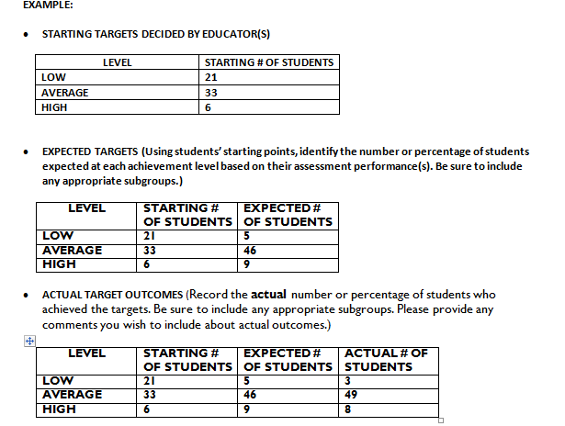
Looking at Targets
Notes:
Let’s explore how this teacher set his targets. Look at the example.
Did the teacher meet the his targets? How would you rate the teacher?

Slide 44
Baseline Data
Information about students’ level of performance at the “start” of the interval of instruction is BASELINE DATA.
Uses recent data available, such as
  prior year’s assessment scores
  results from a beginning of the year benchmark assessment
  pre-assessment data
  other evidence of students’ learning that measure the pre-requisite knowledge and skills necessary for the course
Baseline data are used to establish SLO targets and the amount of growth that should take place within the allotted time period for measuring growth toward the learning goal.
Notes:
Baseline data is information about students’ level of performance at the start of the interval of instruction.
It is generally the most recent data available and can include the prior year’s assessment scores or grades, results from a beginning of the year benchmark assessment, a pre-assessment, or other evidence of students’ learning, such as portfolio work samples that measure the pre-requisite knowledge and skills necessary for the course.
Baseline data are used to establish SLO targets, which are the expected outcome at the end of the instructional period, and consequently, the amount of growth that should take place within the allotted time period. Tiered targets are specific growth targets for individual students or groups of students. They help to more accurately capture an educator’s contribution to learning because goals are not focused on attainment of information, but rather on individual growth.
When baseline data is compared with data collected at later points in the school year, decisions can be made as to whether students are making adequate progress towards targets and goals. The baseline information can be used to measure student change toward important academic indicators during a course or academic year. The key to measuring student learning is to select the appropriate assessments or sources of evidence.

Slide 45
Targets Example: Assess the Quality
Band II Targets:
Based on an informal pre-assessment of students performing a sight reading of a provided piece, student grades in Band I, and a student survey, the following baseline data was used to establish 3 groups and their expected targets: These targets are ambitious and realistic because you cannot have a high quality band without all students able to read music and engage in prescribed musical style with expression. Are appropriate baseline data used to establish and differentiate performance? Are the expectations rigorous, realistic, yet attainable based on the description and targets provided?
Groups | Baseline Data | Expected Targets | Actual Outcomes
Advanced | 5% | 85%
Average | 45% | 15%
Low | 50%
Notes:
Review the following Example Targets section for a Band II course. Use the Targets row in the Utah Rubric for Assessing the Quality of Student Learning Objectives (SLOs) to determine a quality rating for this SLO. Consider:
Are appropriate baseline data used to establish and differentiate performance?
Are the expectations rigorous, realistic, yet attainable based on the description and targets provided?
Be prepared to share. (10 minutes)

Slide 46
Activity: Thinking through Baseline Data to determine Targets
Review Baseline Data Example (Grade 5 PE) illustrating the process for setting targets.
Working with a partner, discuss…
  How this process is similar/different to what teachers currently do?
  What support teachers may need in order to review and analyze data to effectively set SLO targets?
  What shift in thinking is required to demonstrate and be accountable for student growth?
Notes:
This activity will help teachers experience how intuitive and uncomplicated it can be to set targets using baseline data on students.

Slide 47
Example SLOs:
Putting it all together
Professional Development and SLO Planning Template (long version used for training and developing example SLOs for the state
USOE Model SLO Template and Development Guide (used for recording Learning Goal, Assessment, Targets, and Evaluation Ratings)
State content area examples in USOE SLO Bank

Slide 48
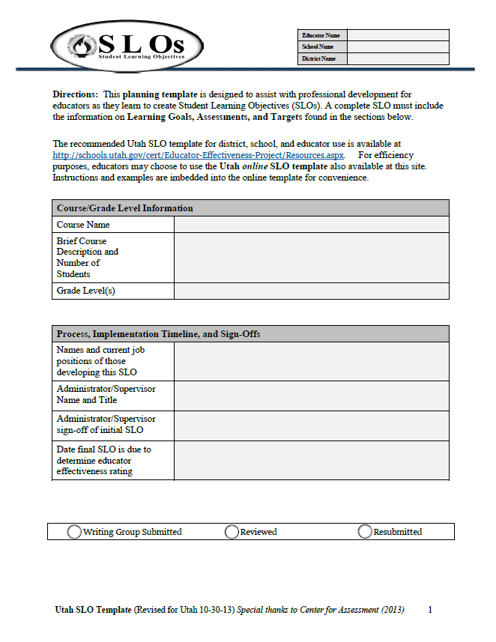
Utah SLO Planning Template
Notes:
Template seems long now but when it is on line it will not be more than three pages. The information and instructions will be in a manual and it will also be electronic so that it the prompts pop up when you hover over the item on the template.
You can download the PDF planning version of the Template that is available in the Webinar.
Another aspect of the Template that is important to understand is that it will be in a PDF version allowing you the educator to make adjustments and adaptations to the Template. Your Administrator/Supervisor will also be able to approve the SLO on the PDF and submit it directly to us for data during the Pilot Study. We will talk more about this later as well.

Slide 49
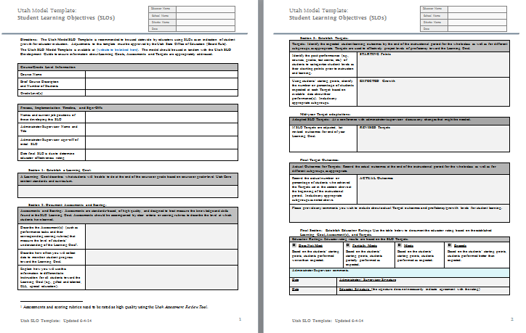
Short Version:
Utah Model SLO Template

Slide 50
Let’s practice!
Look at a state example with a partner
How do you know if it is a quality SLO?
High stakes decisions – need quality SLOs!
High stakes decisions – need comparability and fairness!

Slide 51
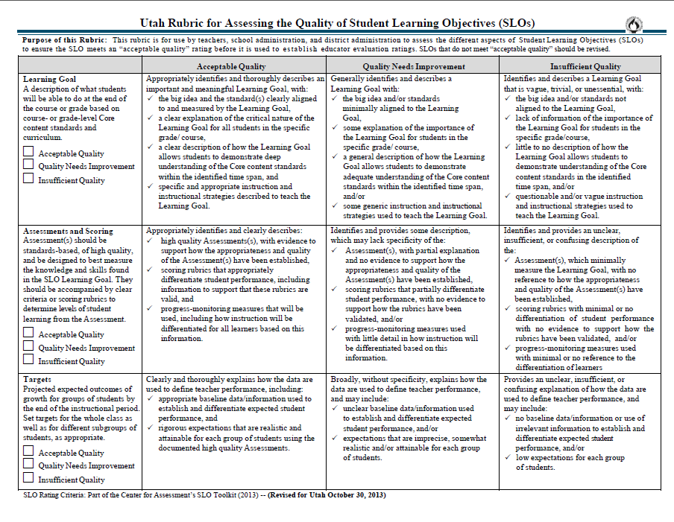
Notes:
Another tool mentioned earlier that helps with setting high quality SLOs is the Rubric for Assessing Quality SLOs. This tool helps an educator or team of educators review the SLOs to ensure that it is ambitious and realistic. We will have PD on this tool and how to use it to increase comparability and consistency district and statewide.
I am including this for you so that you can see how the SLO that you are piloting was vetted for consistency, high quality, and comparability. This Rubric will be used statewide as educators begin to develop their own SLOs in the future.
So let’s talk about how the SLOs were developed…. Next Slide

Slide 52
Activity: Implementing SLOs
At your table, select 1 or 2 SLO examples and discuss:
  What resources, training or support do teachers need to make SLOs a successful and meaningful instructional process?
  What opportunities does the SLO process provide for the districts and schools to support teachers in instructional improvement?

Slide 53

Closing Comments

